Slide 1
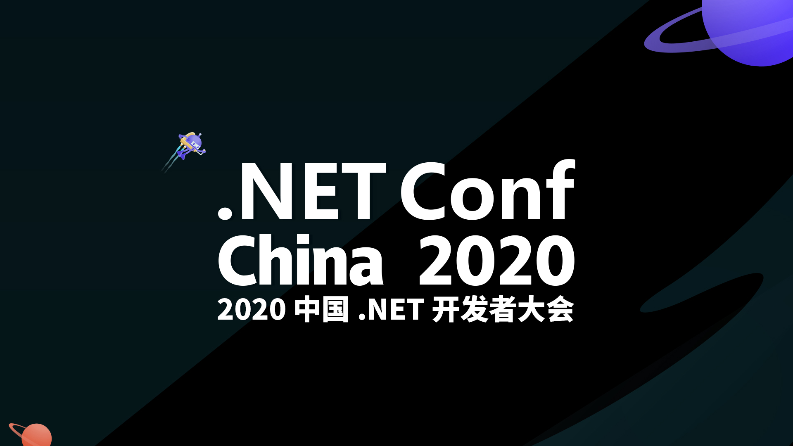

Slide 2

Building Serverless Application With Azure Functions
Li Yu (李宇)
ThoughtWorks – Consultant
2020-12-19

Slide 3
Building Serverless Application With Azure Functions
What’s in this workshop?
Introduction to Azure Functions.
Build a Azure Functions App to aggregate infos and notify you from scratch using .net core.
Through this workshop, you will…
Know what Azure Functions is and what can it do.
Be able to start your own Azure Functions App quickly.
Explorer more possibilities with Azure Functions.

Slide 4
Building Serverless Application With Azure Functions
Multiple Triggers / Input / Output Bindings (custom bindings enabled)
Multiple Develop Languages
Extremely Cheap

Slide 5
What are we going to build?
Building Serverless Application With Azure Functions

Slide 6
Pre-Request
Building Serverless Application With Azure Functions
Visual Studio Code & Azure Tools Extension
Install Azure Functions Core Tools
Azure [Free] Account
.net core sdk (3.1.x+)

Slide 7
Roadmap
Building Serverless Application With Azure Functions

Slide 8
Create Azure Functions App with Resource Group
Building Serverless Application With Azure Functions
1. Create resource group to hold your resources.
2. Create storage account.
3. Create Azure Functions App account.

Slide 9
Check it out on Azure Portal!
Building Serverless Application With Azure Functions

Slide 10
Start Local Development
Building Serverless Application With Azure Functions
1. Create local function project.
$ func init AggregateInfos --dotnet
2. Add new function and config trigger.
$ func new --name AggregateClient
3.(Optional) Config for Mac local develop.
$ # Change AzureWebJobsStorage in local.settings.json
$ az storage account show-connect-string --name netconfchinasa
4. Run from local and debugging.
$ func start

Slide 11
Coding Time!
Building Serverless Application With Azure Functions
Reading and parsing feeds from .netblogs’ rss source.
Building email and send.

Slide 12
Config App Settings
Building Serverless Application With Azure Functions
1.Separate settings from code.
$ az functionapp config appsettings set --name Aggregator --resource-group netconfchina2020-rg --settings NET_BLOG_RSS_URL=“https://devblogs.microsoft.com/dotnet/feed/”
2.Read settings in code.
$ var netBlogRssUrl = System.Environment.GetEnvironmentVariable("NET_BLOG_RSS_URL", EnvironmentVariableTarget.Process);

Slide 13
Config for Accessing Secrets in Azure KeyVault
Building Serverless Application With Azure Functions
1.Create KeyVault.
$ az keyvault create --name workshop-kv --resource-group netconfchina2020-rg
2.Add Secrets to KeyVault.
$ az keyvault secret set --vault-name workshop-kv --name username --value <YOUR_EMAIL_USERNAME>
$ az keyvault secret set --vault-name workshop-kv --name password --value <YOUR_EMAIL_PASSWORD>
3.Turn on managed identities for Azure Functions App.
$ az webapp identity assign --name Aggregator --resource-group netconfchina2020-rg
4.Authorizing Azure Functions App to use KeyVault.
$ az ad sp list --display-name Aggregator --query “[0].appId”
$ az keyvault set-policy --name workshop-kv --spn <appId> --secret-permissions get list

Slide 14
Config for Accessing Secrets in Azure KeyVault
Building Serverless Application With Azure Functions
5.Config Secrets for Azure Functions.
$ az keyvault secret show --vault-name workshop-kv --name username
$ az keyvault secret show --vault-name workshop-kv --name password
$ az functionapp config appsettings set --name Aggregator --resource-group netconfchina2020-rg --settings HOTMAIL_USERNAME=“@Microsoft.KeyVault(SecretUri=<secret_identifier_username>)”
$ az functionapp config appsettings set --name Aggregator --resource-group netconfchina2020-rg --settings HOTMAIL_PASSWORD=“@Microsoft.KeyVault(SecretUri=<secret_identifier_password>)”
6.Access secrets in code.
$ var username = System.Environment.GetEnvironmentVariable("HOTMAIL_USERNAME", EnvironmentVariableTarget.Process);

Slide 15
Publish to Azure Functions App
Building Serverless Application With Azure Functions
1.Publish.
$ func azure functionapp publish Aggregator
2.Monitor.
$ func azure functionapp logsteam Aggregator [--browser]

Slide 16
Showcase(fan che) Time!
Building Serverless Application With Azure Functions

Slide 17
Clean up
Building Serverless Application With Azure Functions
$ az group delete --name netconfchina2020-rg

Slide 18
Building Serverless Application With Azure Functions
LONG LIVE THE .NET & Azure!

Slide 19


Thank You

